Slide 1
Data Analysis Using R
Unit –III
Descriptive Statistics in R

Slide 2
Descriptive Statistics - Introduction
Descriptive statistics is a branch of statistics aiming at summarizing, describing and presenting a series of values or a dataset.
Descriptive statistics is often the first step and an important part in any statistical analysis.
It allows to check the quality of the data and it helps to “understand” the data by having a clear overview of it.
If well presented, descriptive statistics is already a good starting point for further analyses.

Slide 3
Descriptive Statistics - Introduction
There exists many measures to summarize a dataset. They are divided into two types:
location measures and
dispersion measures
Location measures give an understanding about the central tendency of the data
Dispersion measures give an understanding about the spread of the data – measure of variability.

Slide 4
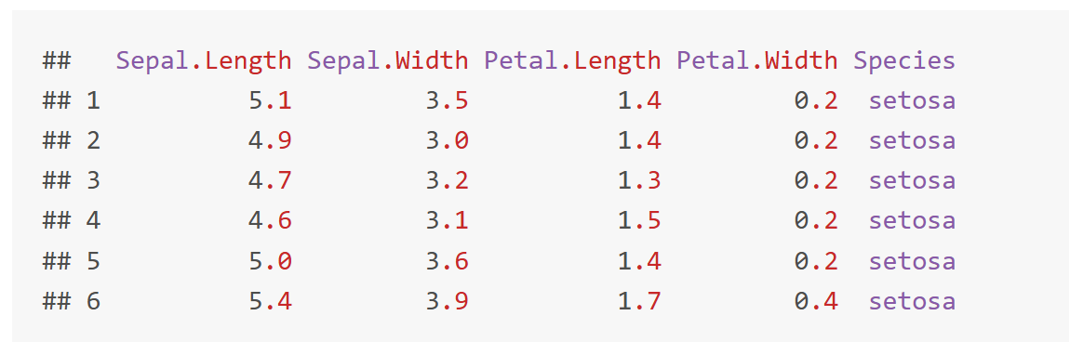
Data - Iris Dataset
Dataset is imported by default in R, you only need to load it by running iris
dat <- iris # load the iris dataset and renamed it dat
head(dat) # first 6 observations

Slide 5
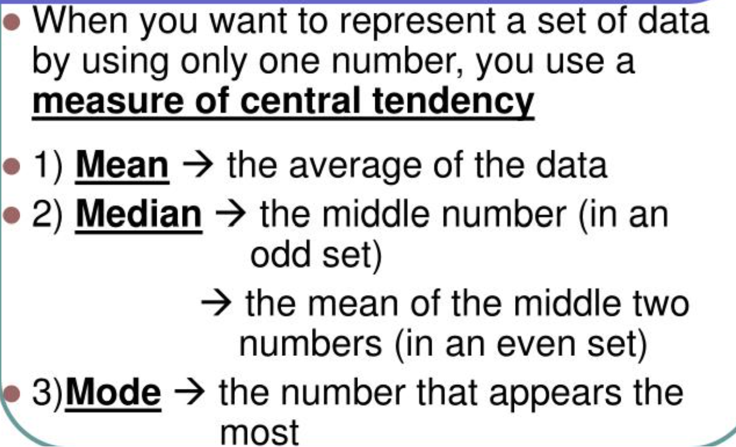
Measures of Central Tendency

Slide 6
Mean → Measure of Central Tendency
The mean is the average value of a set of data points. In R, the mean() function can be used to calculate the mean.
mean(dat$Sepal.Length)
Tips:
If there is at least one missing value in your dataset, use mean(dat$Sepal.Length,na.rm=TRUE) to compute the mean with the NA excluded
For a truncated mean, use mean(dat$Sepal.Length,trim=0.10)
trim varies from 0 to 0.5

Slide 7
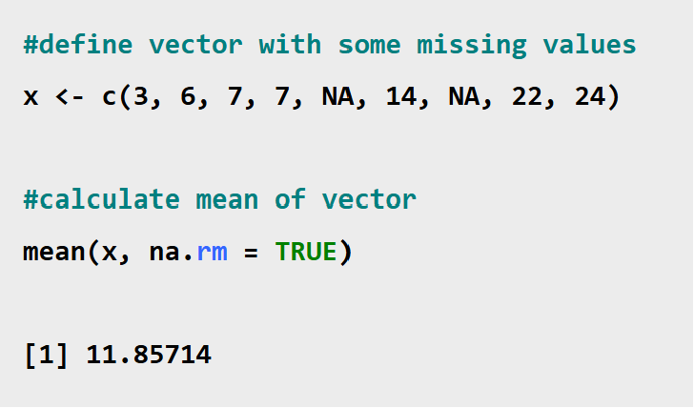
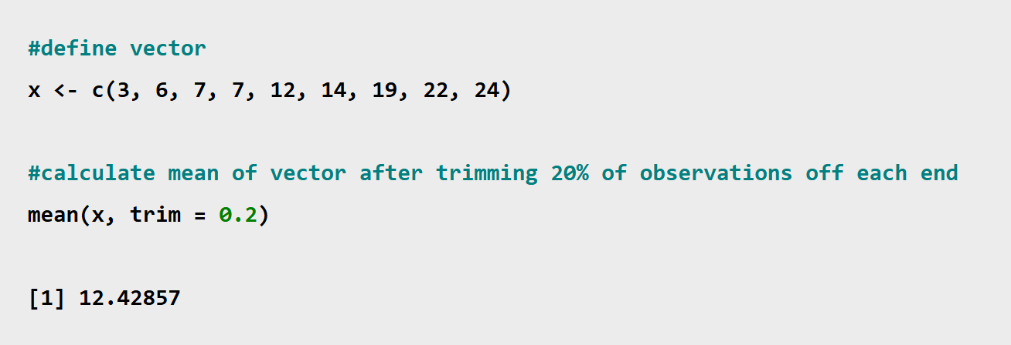
Mean → Measure of Central Tendency

Slide 8
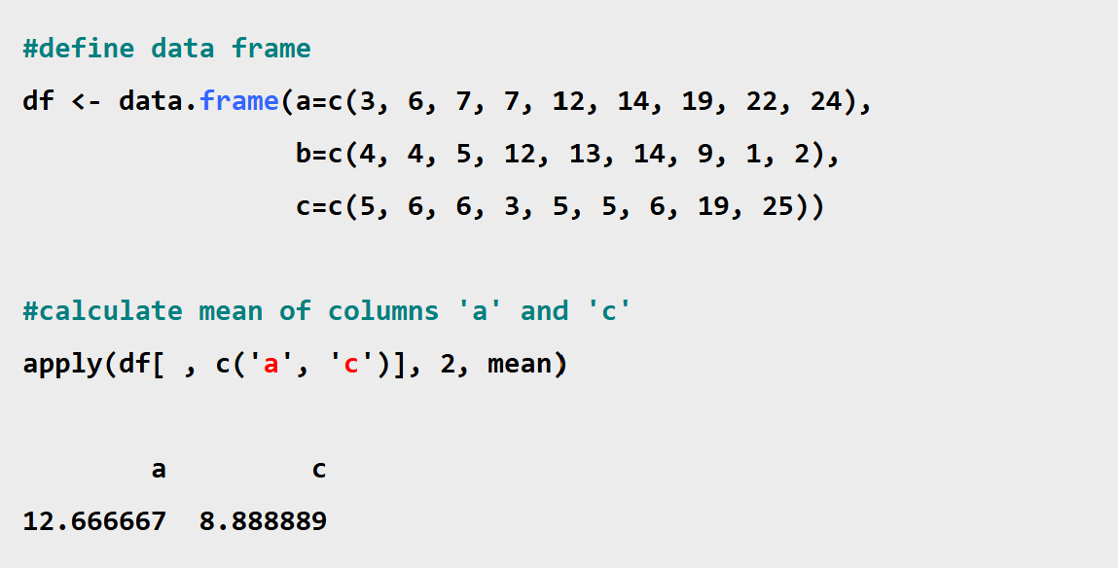
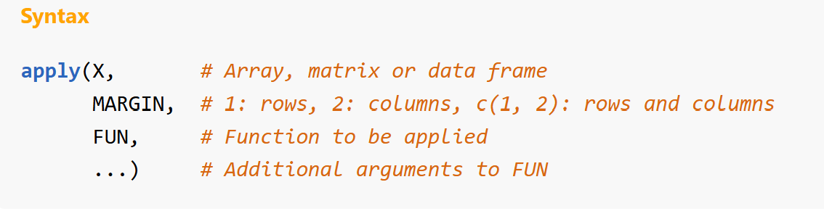
Mean → Measure of Central Tendency

Slide 9
Median → Measure of Central Tendency
The median is the middle value in a set of data points when they are arranged in order. In R, the median() function can be used to calculate the mean.
median(dat$Sepal.Length)
Tips:
If there is at least one missing value in your dataset, use median(dat$Sepal.Length,na.rm=TRUE) to compute the mean with the NA excluded

Slide 10
Mode → Measure of Central Tendency
In R, unlike mean and median, there's no built-in function to calculate mode.
We need to create a user defined function to calculate mode. For example,
# vector of marks
marks <- c(97, 78, 57,78, 97, 66, 87, 64, 87, 78)
# define mode() function
mode = function() {
# calculate mode of marks
return(names(sort(-table(marks)))[1])
}
# call mode()
mode()

Slide 11
Measures of variability
Variability (also known as Statistical Dispersion) is another feature of descriptive statistics.
Measures of central tendency and variability together comprise of descriptive statistics.
Variability shows the spread of a data set around a point.
Example: Suppose, there exist 2 data sets with the same mean value:
A = 4, 4, 5, 6, 6
Mean(A) = 5
B = 1, 1, 5, 9, 9
Mean(B) = 5

Slide 12
Measures of variability
So, to differentiate among the two data sets, R offers various measures of variability.
Variance
Standard Deviation
Range
Interquartile Range

Slide 13
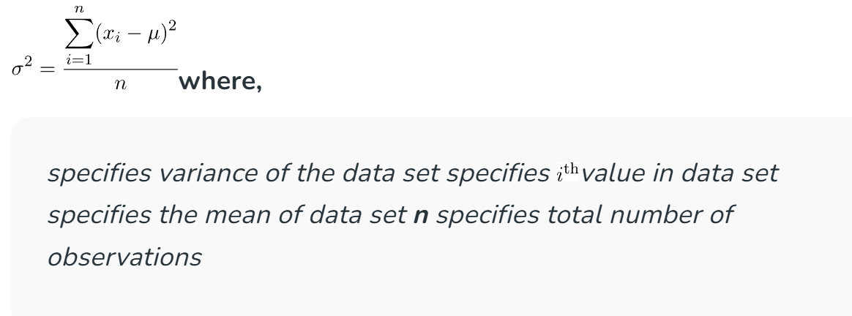
Variance -> Measures of variability
Variance is a measure that shows how far each value is from a particular point, preferably the mean value.
Mathematically, it is defined as the average of squared differences from the mean value.

Slide 14
Variance -> Measures of variability
In the R language, there is a standard built-in function to calculate
the variance of a data set.
Syntax: var(x)
Where x is the data vector
Example
# Defining vector
x <- c(5, 5, 8, 12, 15, 16)
# Print variance of x
print(var(x))

Slide 15
Standard Deviation -> Measures of variability
Standard deviation in statistics measures the spreadness of data
values with respect to mean and mathematically, is calculated as
square root of variance
Example
# Defining vector
x <- c(5, 5, 8, 12, 15, 16)
# Print variance of x
print(sqrt(var(x)))

Slide 16
Range-> Measures of variability
Range is the difference between the maximum and minimum value of a data set.
In R language, max() and min() is used to find the same, unlike range() function that returns the minimum and maximum value of the data set.
The range() function in R is used to return a vector with two elements:
The first element represents the minimum value of the input vector.
The second element is the maximum value of the input vector.
The range() function takes the following parameter values:
First parameter that represents any numeric or character objects or vectors.
na.rm: This takes a Boolean value (TRUE or FALSE) indicating if the NaN (Not a Number) values should be omitted or not.

Slide 17
Range-> Measures of variability
Example
# Defining vector
x <- c(5, 5, 8, 12, 15, 16)
# range() function output
print(range(x)) #5 16
# Using max() and min() function
# to calculate the range of data set
print(max(x)-min(x)) #11

Slide 18
Range-> Measures of variability
# create vector
data = c(12, 45, NA, NA, 67, 23, 45, 78, NA, 89)
# display
print(data)
# find range in vector
print(range(data, na.rm=TRUE))

Slide 19
Range-> Measures of variability
The range tells you the spread of your data from the lowest to the highest value in the distribution
For example: Consider two datasets, dataset 1 has a range of 20 – 38 = 18 while dataset 2 has a range of 11 – 52 = 41. Dataset 2 has a broader range and, hence, more variability than dataset 1.
Because only 2 numbers are used, the range is influenced by outliers and doesn’t give you any information about the distribution of values.

Slide 20
Interquartile Range-> Measures of variability
The interquartile range is the middle half of the data.
To visualize it, think about the median value that splits the dataset in half. Similarly, we can divide the data into quarters.
Statisticians refer to these quarters as quartiles and denote them from low to high as Q1, Q2, and Q3.
The lowest quartile (Q1) contains the quarter of the dataset with the smallest values.
The upper quartile (Q3) contains the quarter of the dataset with the highest values.
The interquartile range is the middle half of the data that is in between the upper and lower quartiles.
In other words, the interquartile range includes the 50% of data points that fall between Q1 and Q3.

Slide 21
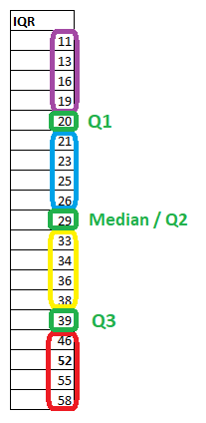
Interquartile Range-> Measures of variability
Interquartile Range is based on splitting a data set into parts called as quartiles.
There are 3 quartile values (Q1, Q2, Q3) that divide the whole data set into 4 equal parts.
Q2 specifies the median of the whole data set. Mathematically, the interquartile range is depicted as:
IQR = Q3 – Q1
where, Q3 specifies the median of n largest values Q1 specifies the median of n smallest values
Here IQR= 39-20 = 19

Slide 22
Interquartile Range-> Measures of variability
quantile(iris$Sepal.Length, 0.25) #Q1- 5.1
quantile(iris$Sepal.Length, 0.75) #Q3 – 6.4
IQR(iris$Sepal.Length) #Q3-Q1 – 6.4-5.1=1.3

Slide 23
Skewness and Kurtosis
In statistics, skewness and kurtosis are the measures that tell about the shape of the data distribution, or simply, both are numerical methods to analyze the shape of data set unlike, plotting graphs and histograms which are graphical methods.
These are normality tests to check the irregularity and asymmetry of the distribution.
To calculate skewness and kurtosis in R language, a moments package is required.

Slide 24

Skewness
Skewness is a measure of the asymmetry of a distribution. This value can be positive or negative.
A negative skew indicates that the tail is on the left side of the distribution, which extends towards more negative values.
A positive skew indicates that the tail is on the right side of the distribution, which extends towards more positive values.
A value of zero indicates that there is no skewness in the distribution at all, meaning the distribution is perfectly symmetrical.
Where, x_{i} -> i th value in the data vector
x -> mean value of the data vector
n-> number of observations

Slide 25
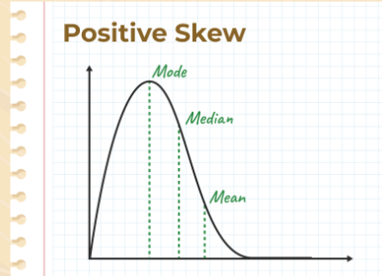
Skewness
Positive Skewness
Positive Skewness means the tail on the right side of the distribution is longer. The mean and median will be greater than the mode.
Condition for positive skewness = Mean > Median >Mode
The positive curve of skewness is shown in the image below,
Let’s take an example of the income distribution where a few people earn very high incomes and the majority earn lower incomes. so, this is often positively skewed. Analyzing skewed data can provide valuable insights into the underlying causes and potential solutions or interventions.

Slide 26
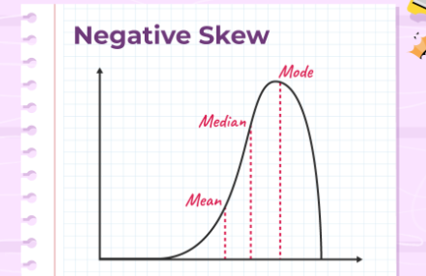
Skewness
Negative Skewness
Negative Skewness means when the tail of the left side of the distribution is longer than the tail on the right side. The mean and median will be less than the mode.
Condition for negative skewness is Mode > Median > Mean
The curve shows negative skewness in the image below,
Let’s take an example of a match, during the match most of the players of a particular team scored runs above 50 and only a few of them scored below 10. In such a case, the data is generally represented with the help of a negatively skewed distribution. And this data is helpful to analyze the game’s performance.

Slide 27
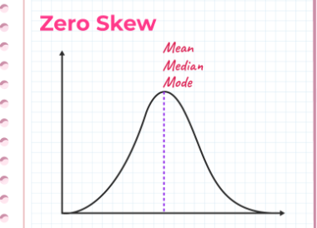
Skewness
Zero Skewness
It is also known as a “symmetric distribution”.It signifies that distribution of data is evenly distributed around the mean, with no long tails on either end of the distribution
Condition for zero skewness is Mean = Mode = Median
The curve for zero skews is shown in the image below,

Slide 28
Skewness
library(moments)
d<-c(25,28,26,30,40,50,40)
skewness(d) # 0.6121401
So skewness for these data is positive, indicates what???
this indicates that the distribution is right-skewed.
library(moments)
d<-c(2,4,6,6)
skewness(d) #-0.4933822
mean(d) #4.5
median(d) #5
So skewness for these data is negative,indicates what???
this indicates that the distribution is left-skewed.

Slide 29

Kurtosis
A statistical measure known as kurtosis measures the peakedness, flatness, and weight of the tails of data distributions.
In a number of disciplines, including finance, economics, social sciences, and data analysis, an understanding of kurtosis is crucial.
Where, x_{i} -> i th value in the data vector
x -> mean value of the data vector
n-> number of observations

Slide 30
Kurtosis
Kurtosis is a measure of whether or not a distribution is heavy-tailed or light-tailed relative to a normal distribution.
The kurtosis of a normal distribution is 3.
If a given distribution has a kurtosis less than 3, it is said to be playkurtic, which means it tends to produce fewer and less extreme outliers than the normal distribution.
If a given distribution has a kurtosis greater than 3, it is said to be leptokurtic, which means it tends to produce more outliers than the normal distribution.

Slide 31
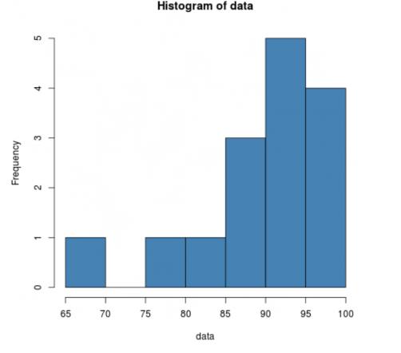
Kurtosis
library(moments)
data = c(88, 95, 92, 97, 96, 97, 94, 86, 91, 95, 97, 88, 85, 76, 68)
kurtosis(data) #4.177865
hist(data)
Since the kurtosis is greater than 3, this indicates
that the distribution has more values in the tails
compared to a normal distribution.

Slide 32
Summary() Function
summary() Function:
The summary() function in R is a versatile tool that provides a concise and informative overview of the key characteristics of a dataset, including numerical and categorical variables.
It is particularly useful for performing initial exploratory data analysis (EDA) to quickly understand the distribution and basic properties of the data.
The function generates a summary output for each variable in the dataset, presenting a variety of descriptive statistics based on the data type.

Slide 33
Summary() Function
For numerical variables, the summary() function produces the following information:
Minimum and Maximum: The smallest and largest values in the dataset.
1st Quartile (Q1), Median (2nd Quartile), and 3rd Quartile (Q3): These are the values that divide the data into four equal parts, providing insights into the central tendency and data spread.
Mean: The arithmetic average of the data points.
Standard Deviation: A measure of the dispersion or spread of the data around the mean.
For categorical variables, the summary() function displays the frequency count of each unique value and the mode (most frequently occurring value).

Slide 34
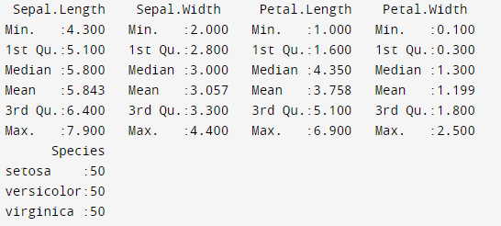
Summary() Function
summary(iris,nar.rm=TRUE)

Slide 35
Describe() Function
The describe() function in R Programming Language is a useful tool for generating descriptive statistics of data.
It provides a comprehensive summary of the variables in a data frame, including central tendency, variability, and distribution measures.
This function is particularly valuable for preliminary data analysis, helping to understand the basic characteristics of the dataset.
The describe() function is available in several R packages, with Hmisc and psych being the most popular.
install.packages(“Hmisc”)
library(Hmisc)
install.packages(“psych”)
library(psych)

Slide 36
Describe() Function – Hmisc Package
library(Hmisc)
# Example data frame
data <- data.frame(
age = c(25, 30, 35, 40, 45, NA),
income = c(50000, 60000, 65000, 70000, 75000, 80000),
gender = factor(c("male", "female", "female", "male", "male", "female"))
)
# Using describe() from Hmisc
describe(data)
The output includes the number of observations (n), missing values (missing), unique values (unique), mean, standard deviation (sd), and various percentiles for numeric variables. For factor variables, it shows the count and the unique categories.

Slide 37
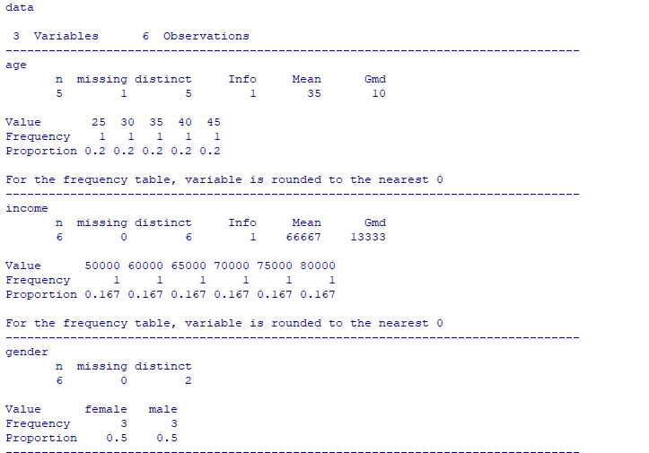
Describe() Function

Slide 38
Describe() Function - psych Package
The describe() function from the psych package also provides a summary of descriptive statistics, but with a focus on psychological data. It includes measures such as skewness and kurtosis.
Output includes the following:
vars indicates the variable index.
n is the number of non-missing values.
mean is the average.
sd is the standard deviation.
median is the middle value.
trimmed is the mean after trimming 10% of the observations from each tail.
mad is the median absolute deviation.
min and max are the minimum and maximum values.
range is the difference between the maximum and minimum.
skew is the skewness of the distribution.
kurtosis is the measure of the “tailedness” of the distribution.
se is the standard error.

Slide 39
Describe() Function – psych Package
library(pysch)
# Example data frame
data <- data.frame(
age = c(25, 30, 35, 40, 45, NA),
income = c(50000, 60000, 65000, 70000, 75000, 80000),
gender = factor(c("male", "female", "female", "male", "male", "female"))
)
# Using describe() from Hmisc
describe(data)

Slide 40
Descriptive statistics by group
We may want to calculate descriptive statistics for each column in a data frame in R, grouped by a particular column.
One of the easiest ways to do so is by using the describeBy() function from the psych package in R, which can be used to perform this exact task.
The describeBy() function uses the following syntax:
describeBy(x, group=NULL, …)
Where,
x: Name of data frame
group: A grouping variable or list of grouping variables

Slide 41
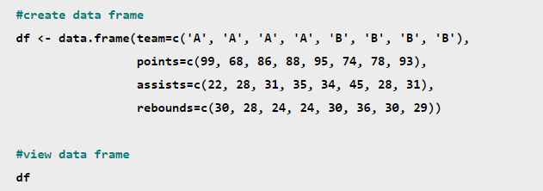
Descriptive statistics by group
Suppose that we create the following data frame in R that contains information about various basketball players:

Slide 42
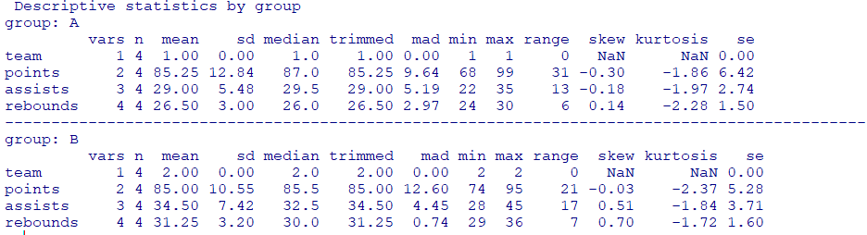
Descriptive statistics by group
To calculate descriptive statistics for each of the numeric variables in the data frame, grouped by the values in the team column.
library(pysch)
describeBy(df, df$team) #grouping one variable
describeBy(df, list(df$team,df$points)) #grouping two variables

